Slide 1
Making this resource work for you
Prior to teaching this lesson, please refer to the ‘Unit Overview and Planning Document’.
Further guidance on planning Science Mastery lessons can be found in the detailed planning guidance document.
Refer to the ‘notes’ section on each slide for useful information, including suggested expositions, pedagogical content knowledge, suggested questions, answers and more. Consider using presenter mode so you can see this guidance throughout the lesson.
The introduction slides can be adapted to suit your teaching style and the needs of your class.
Before the lesson, adapt the fix-it slide to address any misconceptions identified in the previous lesson’s exit ticket.
Choose from the suggested activities to suit your class. The intention is not that you complete all of these, but that you select those which ones are most appropriate for your students. It may be appropriate to further adapt activities for your students.
These lessons are designed to occupy approximately 1 hour. To adapt for a shorter or longer lesson duration we advise you to adapt the activity section accordingly.
Please consider using the final slide to send feedback about this lesson or examples of PowerPoints that you have adapted to our design team. Your feedback is used to improve Science Mastery for all of our teachers and students. We appreciate all suggestions and comments.
Thank you for reading!
The Science Mastery Team

Slide 2
Food Security
Answer the questions below:
State two methods of maintaining fish stocks.
State two biological consequences of global warming.
Explain why energy is lost between trophic levels in a food chain.
What is the name of an animal that eats only plants?
Calculate the efficiency of the biomass transfer when there is 500 kg biomass in trophic level 1 and 40 kg biomass in trophic level 2.
Restricting net size and using fishing quotas.
Loss of habitats, changing breeding patterns and changing migratory patterns
Some biomass is lost as waste (urine, faeces, sweat etc) and some is used for life processes, such as movement, growth and thermoregulation.
Herbivore / primary consumer
(40 kg / 500 kg) x 100 = 8%
Notes:
Purpose: to assess learning from previous lessons.
Foundation question: State the definition of a producer.
Answer: an organism that makes its own food (glucose) using sunlight.
Stretch question: Explain why vegetarianism is a referred to as a sustainable diet choice.
Answer: vegetarianism means that humans become the primary consumer, reducing the number of trophic levels in the food chain, thereby providing more energy/biomass and producing less waste.

Slide 3
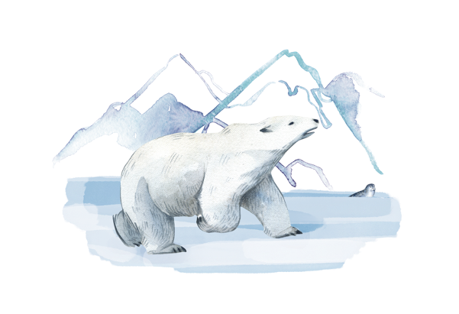
B3.2.9
12/04/2024
Taking It Further: Food Security
B3.2.1 Prior Knowledge Review
B3.2.2 Biodiversity
B3.2.3 How Humans Affect Biodiversity
B3.2.4 How Humans can Preserve Biodiversity
B3.2.5 The Effect of Pollution on Biodiversity
B3.2.6 Global Warming
B3.2.7 Taking It Further: Pyramids of Biomass
B3.2.8 Taking It Further: Farming and Biotechnology
B3.2.9 Taking It Further: Food Security
Notes:
Big Idea: Organisms are Interdependent
Pupils have previously learnt about biodiversity, the effects humans have on organisms around them and the efficiency of food chains. This lesson focusses on how the efficiency of food chins is taken into account during farming and how technology can be used to overcome inefficient biomass transfers.
Suggested Hook:
Did you know that 57% of land in the UK is used for agriculture? But only 5.4% of land is arable land (used for growing crops -the majority of this is cereals and grains, such as wheat). So what else is all the agriculture land used for? Mainly used as pastureland (including meadows and pastures used for rearing livestock like sheep and cows). As farming is a business, lets look at the ways that farmers maximise the money they make from rearing livestock and whether these methods are overall a good idea or not.
https://cropscience.bayer.co.uk/blog/articles/2019/10/farming-facts/

Slide 4

Following this lesson, students will be able to:
State the definition of food security
Describe factors that may threaten food security
Explain what is meant by sustainability
Key Words:
famine
food security
sustainability
drought
Notes:
Can be edited depending on class need.

Slide 5
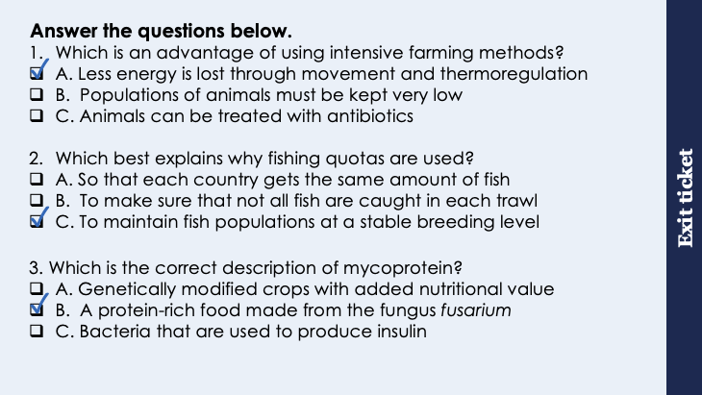
This is the fix-it portion of the lesson
The fix-it is an opportunity to respond to gaps in knowledge, especially those identified by the previous lesson’s exit ticket.
The teacher should customise this slide as needed, to facilitate
reteach, explanation, demonstration or modelling of ideas and concepts that students have not yet grasped or have misunderstood.
practise answering specific questions or of key skills.
redrafting or improving previous work.
Notes:
Purpose: to spend time on any gaps identified in previous learning from exit ticket feedback.
Suggested guidance from previous exit ticket:
Q1. Answer: A
If students answer B or C, they may have not understood the purpose of intensive farming. To fix-it, go through the reasoning behind intensive farming and then they could use practice of determining more advantages and disadvantages of intensive farming methods (similar to Q2 on the worksheet for this lesson).
Q2. Answer: C
If students got Q2 wrong they have not understood the difference between fishing quotas and restricting net size, quotas are used to ensure that each country gets a fair supply but the reason for this is that populations have to remain at a level where breeding can happen. To fix-it, it may be useful to show examples of different types of quota (such as whale quotas in Scandinavian countries).
Q3. Answer: B
If students answer A or C, they need to practice identifying the different applications of biotechnology – this is covered in greater detail in B3.3. To fix-it, in this incidence break down the word mycoprotein. Myco means fungus and then protein hence protein grown from a fungus.

Slide 6
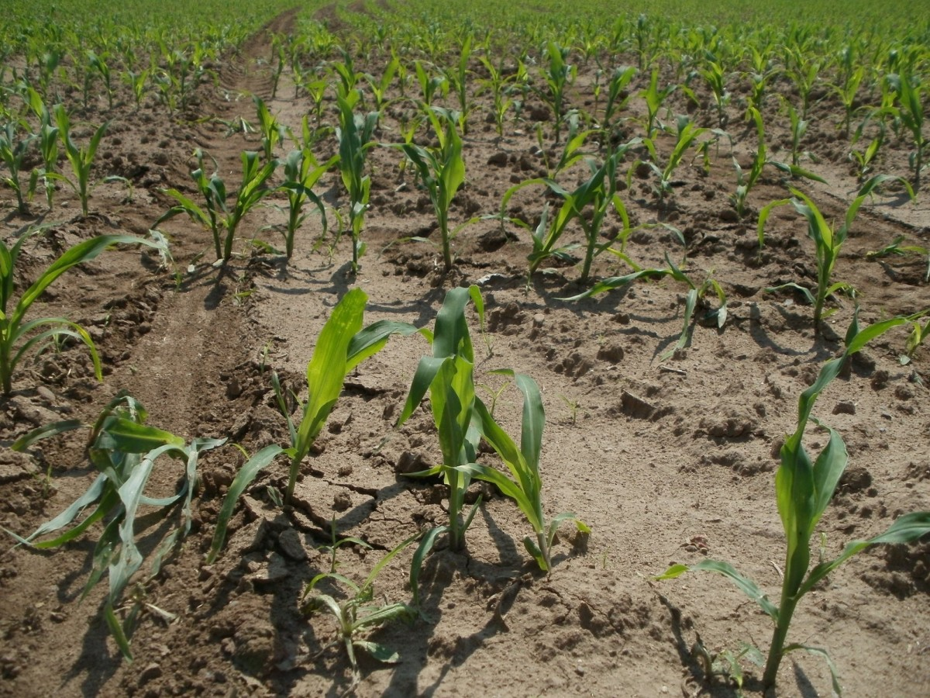
Food Security
Food security is having enough food to feed a population
A number of biological factors can threaten food security:
Increasing birth rate in some countries
Changing diets in developed countries
New pests and pathogens
Droughts or flooding
Cost of agricultural inputs e.g. fertilisers
Conflicts in parts of the world
Notes:
Purpose: introducing new knowledge
Type of exposition: explanation
Suggested Script:
Food security means having enough food to feed a population. Just growing the food isn’t enough, each person needs to be able to access food. It is also important that the population can access a balanced diet to prevent deficiency diseases and diet related health problems.
Without food security people are at risk of malnutrition and even starvation. There are many biological factors that can threaten food security around the world:
Birth rate is the number of live births per thousand of population per year – if the birth rate is higher than the death rate, the population is increasing and there may not be enough food for a population that is constantly increasing.
Changing diets in developed countries/’the Western Appetite’ – more demand in developed countries for resources that are becoming scarce, threatening local food security.
A pest is an animal that eats crops and pathogens are microbes that cause diseases, such as bacteria and viruses causing infections. How would a new pest or pathogen affect food security? They could kill or harm crops/livestock which then can’t be used as food.
A drought is a period of time when an area or region experiences below-normal precipitation, meaning that crops simply do not have enough water to photosynthesise and grow. Drought is not the only unfavourable weather that affects plants - flooding also causes nutrient leaching so crops are unable to get the required minerals.
Cost of agricultural inputs refers to products permitted for use in organic farming. These include feedstuffs, fertilisers and permitted plant protection products as well as cleaning agents and additives used in food production. What would happen if the price of fertilisers increased? It would cost more for farmers to produce the same amount of food. Either farmers would therefore produce less food or the cost of food would then increase. Both of these scenarios will affect food security.
Conflicts in parts of the world, such as civil wars, threaten land available for crops as well as the availability of safe water.
Image source
https://pxhere.com/en/photo/897459
https://pxhere.com/en/photo/711040

Slide 7
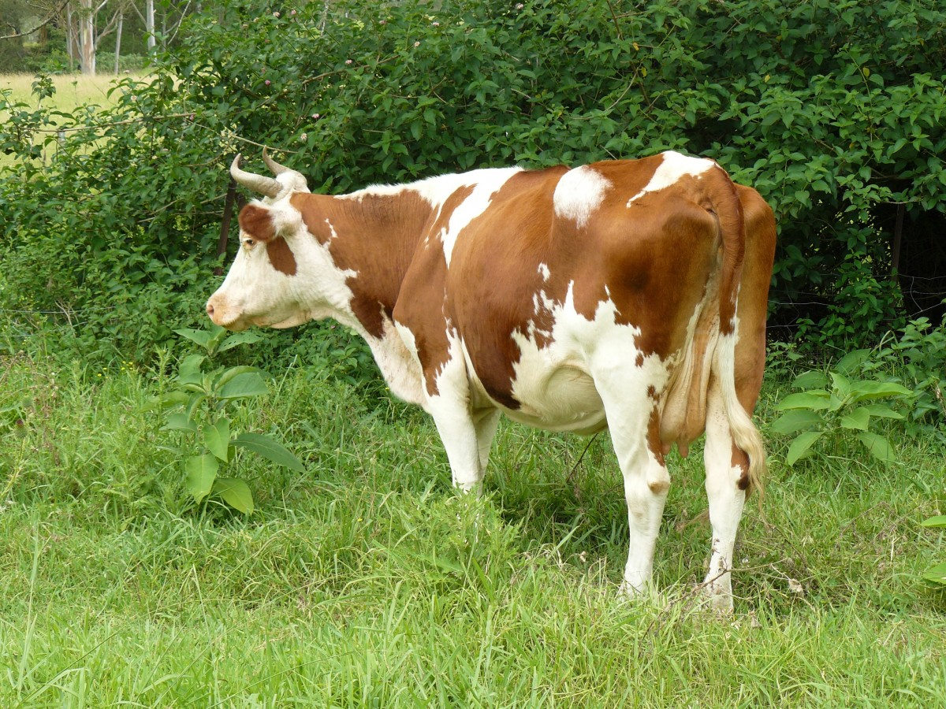
Improving Food Security
Sustainable methods must be found to feed all people on Earth
Sustainability means supporting long-term ecological balance by not depleting natural resources
Food security can be increased by making food production more efficient
Food security can be improved by:
reducing meat intake and eating more food products from producers
eating local, seasonal produce where possible
Notes:
Purpose: introducing new knowledge
Type of exposition: explanation
Suggested Script:
Because of all the factors that are threatening global food security, sustainable methods must be found to feed everyone.
The definition of sustainability is supporting long-term ecological balance by not depleting natural resources.
In order to increase food security food production across the world needs to be more efficient. However, this needs to be balanced with the ethical objections to intensive farming methods as we looked at before. Remind me, what are some examples of intensive farming methods? Reducing the movement of animals, controlling the surrounding temperature so less energy is used for thermoregulation and feeding animals a high protein diet for increased muscle growth.
People often think that food security is not something that currently affects them and therefore they can’t do anything about it. This is not true, there are simple things that every person can do to improve food security:
Reducing meat intake reduces the environmental impact of animal farming. Why does rearing animals have a high impact on the environment? Some animals (eg cows) release methane which is a greenhouse gas. Deforestation often occurs to clear land for rearing animals. Land already cleared could be used for crops instead. If all people did this there would be less need for land to be used as pastureland for rearing livestock and more land would be available to grow crops. A vast amount of grain and cereal crops grown on arable land is fed to livestock, reducing the amount of animal products you eat and increasing the amount of plant based foods means again that fewer animals would need to be reared and some of this grain used as animal feed could be given to humans.
Why do you think eating local and/or seasonal produce makes food production more sustainable? Eating local and seasonal produce reduces the overall emissions that a food may have, eating locally and seasonally means food does not travel far. Many western countries have increased the variety in their diets by importing vast quantities of produce which could be sold (more cheaply) to local people and increase their food security.
List of British seasonal fruit and veg found here:
https://www.bda.uk.com/food-health/your-health/sustainable-diets/seasonal-fruit-and-veg-a-handy-guide.html
Additional information for teachers:
There is a huge amount of media coverage on food security, which can make a really interesting research project for pupils – to investigate the future of sustainable methods of farming and agriculture.
Some good examples to use for changing diets in developed countries are the rise in popularity of avocado and quinoa, which have not traditionally been eaten in large quantities but are now very trendy:
https://geographical.co.uk/opinion/item/3335-western-appetities
This can lead to an interesting debate on “vegan” foodstuffs, where the environmental cost (i.e. all the energy needed to transport it thousands of miles) of transporting niche resources is actually much greater than it would be to have local meat.
Many pupils will automatically assume that a drought is the only unfavourable weather that affects plants but flooding also causes nutrient leaching so crops are unable to get the required minerals.
Image source
https://pxhere.com/en/photo/858884

Slide 8
Quick Quiz
Determine if the following statements are true or false:
Food security is having enough food to feed a population
Food security is only a threat to developing countries
A decreasing birth rate is a threat to food security
Food security is a local issue
True
False
False
False
Notes:
Purpose: review of new information.
Answer in books/MWBs. Cold call or snowball questioning to answer questions. Ensure that answers that are not completely correct are challenged and false statements are corrected.
Answers:
True
False – developing countries are particularly at risk but many developed countries depend on developing countries for a huge variety of their diets.
False – decreasing birth rate would mean a declining population, increasing birth rate is a risk to food security.
False – food security is a global issue, it may affect different countries/places at different times but could affect the entire population on Earth.

Slide 9




Which statements do you agree with?
Sustainability means that our needs are met without compromising resources for future generations
Food security is where each person gets the same amount of food
Food security should be an issue for each government separately
Crops can only be affected if there is not enough rain
Notes:
Answers:
These are meant to draw out some of the main misconceptions that pupils have about food security and sustainability.
Blue – incorrect, it is having enough food to feed the whole population. It may be worth revisiting energy requirements to highlight that people need different amounts of food.
Yellow - correct, there are many ways to define sustainability but essentially it is about balancing need with use of resources, so that resources are not depleted.
Green - although this is an opinion question, it is useful to guide pupils to the idea that food security is a global issue because of imports and exports (particularly to Western countries).
Pink - incorrect, flooding can also be harmful to crops, where excess water causes nutrients to be leached out of the soil.
Suggested guidance:
Talk tasks can be used in a variety of ways to suit the particular needs of the students you are teaching. Through exchanging views with others, students develop their understanding of the science beyond what could be achieved individually.
Science classrooms that successfully integrate talk have the following features:
Science talk is a regular feature of lessons and is woven into classroom activities.
Students are paired or grouped strategically by the teacher to ensure productive interaction. This might take into consideration the students’ proficiency of the English language, how encouraging they might be to peers and their attainment in the topic. It’s a good idea to consider these pairings in the class seating plan.
Students are encouraged and supported to talk, but are not forced to talk.
The teacher should take on the role of a facilitator, engaging with conversations where necessary and encouraging or steering the conversation where needed.
Students are encouraged to use the language they have to express their ideas (e.g., everyday language, imperfect English, native language), but also to incorporate science specific terminology where this is more accurate or has been taught.
6. Scientifically inaccurate ideas are not dismissed by the partner or teacher; open discussion and further investigation are relied on to help students construct ideas that support them to progress in their scientific understanding.
7. Guidelines for behaviour during talk tasks are explicit and frequently reviewed. Rules for students might be:
Listen carefully to your partner
Take turns talking.
Speak one at a time, without interrupting.
Politely agree or disagree and explain why.
Politely point out if your partner has used a scientific word incorrectly, if they have explained the science incorrectly, or if there is a more accurate way to describe something.
If confused, ask questions.
Stay focused on the discussion topic.
Respond to one another.

Slide 10
Drill
Define food security.
State one biological factor that can threaten food security in developed countries.
State one biological factor in agriculture that can threaten food security.
State one other biological factor that can affect food security.
Define sustainability.
Notes:
Purpose: This is a knowledge drill. The purpose of this is to check that the critical knowledge is secure before pupils move onto independent practice.
Suggested guidance: There are a range of ways this could be done depending on time and ability range of the class:
Mini whiteboards
As full sentences in exercise books
As short answers in exercise books
In the pupil workbook
As pair talk
As cold call

Slide 11
Drill answers
Food security is having enough food to feed a population
Changing diets in developed countries
Cost of agricultural inputs
Increasing birth rate in some countries/new pests and pathogens/ droughts or flooding/conflicts in parts of the world
Sustainability means supporting long-term ecological balance by not depleting natural resources
Notes:
Purpose: This is a knowledge drill. The purpose of this is to check that the critical knowledge is secure before pupils move onto independent practice.
Suggested guidance: There are a range of ways this could be done depending on time and ability range of the class:
Mini whiteboards
As full sentences in exercise books
As short answers in exercise books
In the pupil workbook
As pair talk
As cold call

Slide 12

I: Explain using scientific understanding to make something clear or state the reason for something happening
Example question:
To ‘explain’ your answer should:
Begin with a scientific statement.
Use ‘this means that’, ‘because’ or ‘so’ to link your statement to the question.
The increasing human population has caused a decline in fish stocks.
Explain how fishing quotas can help to return fish stocks to a sustainable level.
Model answer:
Fishing quotas limit the number of fish caught
This means that fewer fish are caught so more fish survive to reproduce
Notes:
This slide models the process of answering an explain question.
Firstly, students are presented with a generic explain question, along with a model answer. Students are also given some simple guidance to follow for producing their own describe answer.
The generic question and answer should be used by the teacher to remind students of
the key features of a great answer
how to structure their answer
why the model answer is a good example
Following this, students will be required to apply this process to answer their own explain question, which will appear in place of the generic questions. This explain question will be specific to the topic students are learning about in the lesson. Give students time to write their own answer to this, ensuring that they use the guidance provided. To further scaffold this task for students, it may be appropriate to:
pair students up to write an answer together
list for students the key words you would like them to include in the answer
provide a writing frame or ‘points to include’ for students
A model answer for this question will appear. Teachers should review the model answer with students by referencing the guidance in the green box. For example ‘we can see item 1 in the guidance is to begin with a scientific statement. Notice in the model answer here we have done just that’. Or ‘item 2 in the guidance here says that we should use a linking statement in the answer. Has this been achieved in the model answer? Where can we see this?’.

Slide 13
We: Explain using scientific understanding to make something clear or state the reason for something happening
Example question:
To ‘explain’ your answer should:
Begin with a scientific statement.
Use ‘this means that’, ‘because’ or ‘so’ to link your statement to the question.
Herring fish can live up to 12 years and reproduce between 3-4 years old. One law to improve food security is to control mesh size of fishing nets, meaning that herring fish under 5 years do not get caught.
Explain how the control of mesh size of fishing nets has helped to conserve stocks of herring.
Model answer:
Controlling mesh size means that smaller or younger fish are not caught
This means they can survive to reproduce
This increases numbers of herring fish
Notes:
This slide models the process of answering an explain question.
Firstly, students are presented with a generic explain question, along with a model answer. Students are also given some simple guidance to follow for producing their own describe answer.
The generic question and answer should be used by the teacher to remind students of
the key features of a great answer
how to structure their answer
why the model answer is a good example
Following this, students will be required to apply this process to answer their own explain question, which will appear in place of the generic questions. This explain question will be specific to the topic students are learning about in the lesson. Give students time to write their own answer to this, ensuring that they use the guidance provided. To further scaffold this task for students, it may be appropriate to:
pair students up to write an answer together
list for students the key words you would like them to include in the answer
provide a writing frame or ‘points to include’ for students
A model answer for this question will appear. Teachers should review the model answer with students by referencing the guidance in the green box. For example ‘we can see item 1 in the guidance is to begin with a scientific statement. Notice in the model answer here we have done just that’. Or ‘item 2 in the guidance here says that we should use a linking statement in the answer. Has this been achieved in the model answer? Where can we see this?’.

Slide 14
You: Explain using scientific understanding to make something clear or state the reason for something happening
Example question:
To ‘explain’ your answer should:
Begin with a scientific statement.
Use ‘this means that’, ‘because’ or ‘so’ to link your statement to the question.
Food security can be increased by making food production more efficient.
Explain how the intensive farming of pigs increases the efficiency of food production.
Model answer:
Intensive farming means that animals are kept inside in a warm environment
So, less energy lost in thermoregulation
Pigs are kept enclosed or in a restricted environment
So, less energy required for movement
This means that more energy is available for growth
Notes:
This slide models the process of answering an explain question.
Firstly, students are presented with a generic explain question, along with a model answer. Students are also given some simple guidance to follow for producing their own describe answer.
The generic question and answer should be used by the teacher to remind students of
the key features of a great answer
how to structure their answer
why the model answer is a good example
Following this, students will be required to apply this process to answer their own explain question, which will appear in place of the generic questions. This explain question will be specific to the topic students are learning about in the lesson. Give students time to write their own answer to this, ensuring that they use the guidance provided. To further scaffold this task for students, it may be appropriate to:
pair students up to write an answer together
list for students the key words you would like them to include in the answer
provide a writing frame or ‘points to include’ for students
A model answer for this question will appear. Teachers should review the model answer with students by referencing the guidance in the green box. For example ‘we can see item 1 in the guidance is to begin with a scientific statement. Notice in the model answer here we have done just that’. Or ‘item 2 in the guidance here says that we should use a linking statement in the answer. Has this been achieved in the model answer? Where can we see this?’.

Slide 15
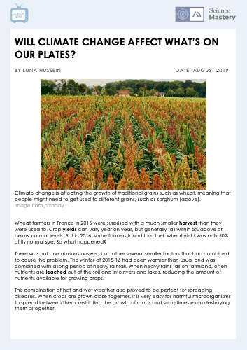
Food Security
Complete the Science in the News activity
Notes:
Purpose: application of new information.
This activity is a shorter/adapted version of the original article, which you may want to use for higher ability classes. It can be found at: https://www.sciencenewsforstudents.org/article/climate-change-global-warming-food-eating

Slide 16
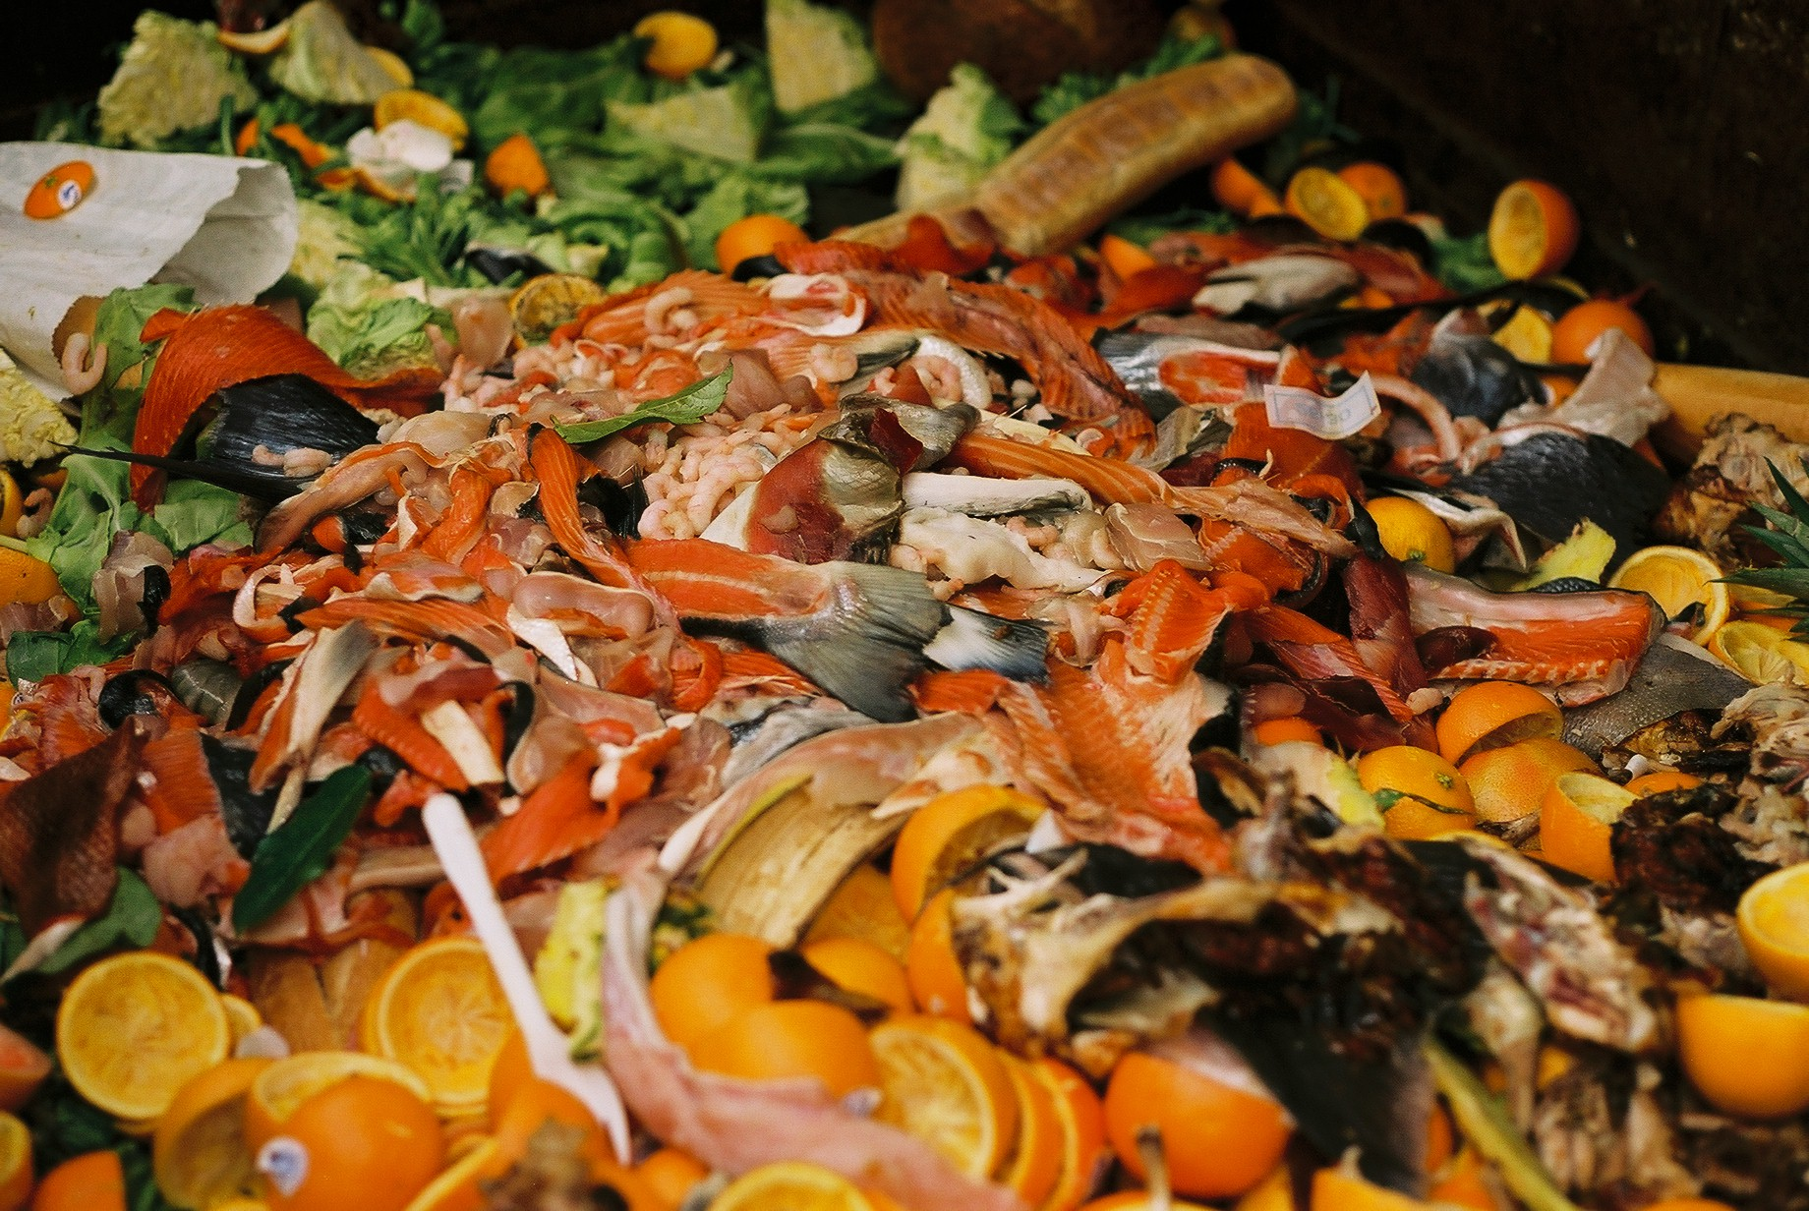
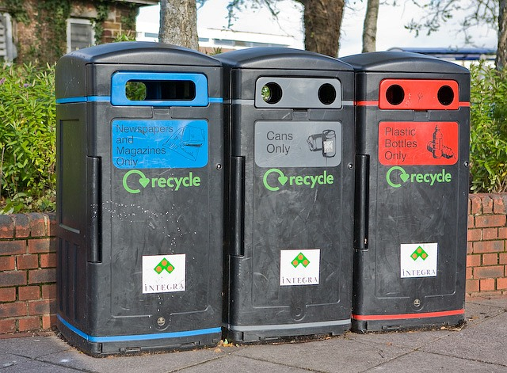
Food Security
Research shows that 6.6 million tonnes of household food waste was thrown out in the UK in 2018, compared to 8.1 million tonnes in 2007.
Of the 6.6 million tonnes thrown away, 70 % was food that could have been eaten.
Answer these questions:
Describe what has happened to the amount of food waste produced by the UK.
Suggest reasons for this change.
Does this mean that everyone has too much food?
Suggest some initiatives or advice you could give people to reduce the amount of food waste that is produced
Notes:
Purpose: application of new information.
This can be used as an alternate activity, if time will not allow for both.
Answers:
The amount of food waste has decreased.
People are more aware of the threats of food security, more people have food waste bins that can be composted.
Although this means that some people have enough food (in fact, too much food), some people may not. If people buy the correct amount of food there is less of a threat to food security.
Suggestions (from FoodCycle):
Buy and cook only what you need.
Don't throw away leftovers right away. Get creative with it!
Organise food at home.
Use food as fertiliser by making your own compost using food waste.
Volunteer for, support, or donate to charities (there are a growing number of food companies that donate their unsold produce to homeless shelters, as well as a number of new supermarkets being set up to sell food that is almost/just past its sell by date at reduced prices.
Image source
https://commons.wikimedia.org/wiki/File:GI_Market_food_waste.jpg
https://commons.wikimedia.org/wiki/File:Colour-coded_recycling_bins_outside_Somerfield,_Lower_Northam_Road_-_geograph.org.uk_-_1041984.jpg

Slide 17
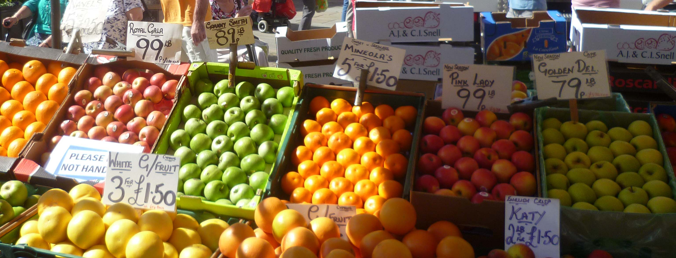
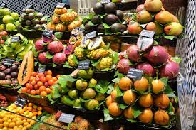
Food Security
52 % of food consumed in the UK is grown in the UK, the other 48 % is imported from many countries across the world.
Explain the advantages and disadvantages of relying on other countries for such a large proportion of the UK’s food supply.
Notes:
Purpose: application of new information.
This can be used as an alternative activity, if time will not allow for both.
Advantages:
Imported food may be cheaper
Land can be used for other uses than growing food
Wider variety of food
Disadvantages
Local farmers may lose jobs
Imported food often has more packaging
Transporting food contributes to greenhouse gases and global warming
Perishable food may have chemicals added to stop it from going off on the journey
Seasonal British fruit and veg list found here for info:
https://www.bda.uk.com/food-health/your-health/sustainable-diets/seasonal-fruit-and-veg-a-handy-guide.html
Optional:
https://www.dailymail.co.uk/sciencetech/article-3643363/How-far-food-travelled-Interactive-map-shows-world-s-food-comes-from.html
Image source
https://commons.wikimedia.org/wiki/File:Typical_UK_fruit_and_vegetable_stall_2013.jpg
https://pxhere.com/en/photo/799224

Slide 18
Answer the questions below.
Which is the best definition of food security?
A. Every person having the same amount of food
B. Having a sufficient amount of food for a population
C. Making sure that crops are protected against droughts or floods
2. Which is least likely to be a threat to food security?
A. A decreasing birth rate
B. A new resistant pathogen (disease-causing microorganism)
C. An ongoing political conflict
3. Which is the best definition of sustainability?
A. Ensuring that food supplies never run out
B. Supporting long-term ecological balance by not depleting natural resources
C. Using farming and agricultural methods that are environmentally friendly and considerate of animals
✓
✓
✓
Notes:
Q1. Answer: B
If students answer A or C, they may have not understood food security. To fix-it, reteach on the definition of food security, as well as a recap of metabolism and energy requirements, as not all people require the same amount of food.
Q2. Answer: A
If students answer B or C, they may not have linked each one to why it could affect food security. To fix-it, they may find it useful to write a list of the factors that affect food security and explain how each one affects it.
Q3. Answer: B
If students answer A, they have thought of food security not sustainability. Option C could be a very basic definition but is not a good enough definition. To fix-it, they could use practice linking back to renewable energy resources and why we use these. Sustainability is not a required definition for pupils but it helps them understand why we need to use more sources of renewable energy and use environmentally friendly methods of farming and agriculture

Slide 19
Lesson B3.2.9
What was good about this lesson? | What can we do to improve this lesson?
Send us your feedback by clicking this link
or by emailing sciencemastery@arkonline.org
Thank you!

